Slide 1
Collegiate Basketball Strength of Schedule Analysis on Time Rested and Distance Traveled
Performed by Jared Grooms

Slide 2
Total Distance Traveled and Time Rested Proved to be Significant Factors on Basketball Performance
Data was collected from basketball-reference for each Division 1 college basketball team from the 2018-2109 season
Distance traveled was computed using Google Maps and the ggmap package in R
All performance metrics are from the traveling team’s point of view
These metrics were analyzed using random forest, linear regression, and gradient boosting models with time rested and distance traveled as predictors
  Point Margin
  Field Goal Percentage
  Turnover Ratio
  Personal Fouls
  Win/Loss
Most metrics had trends that could be graphed, but the effect size still needs to be determined

Slide 3
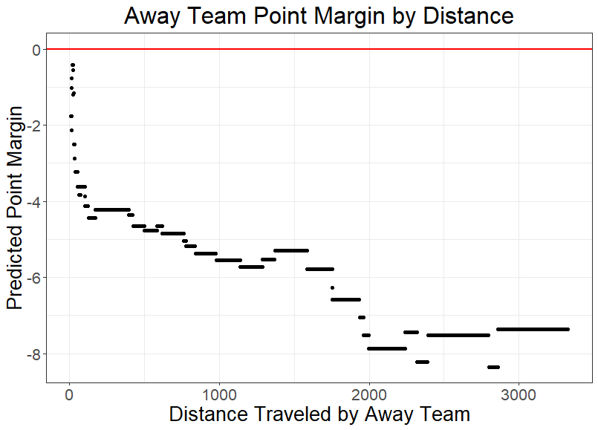
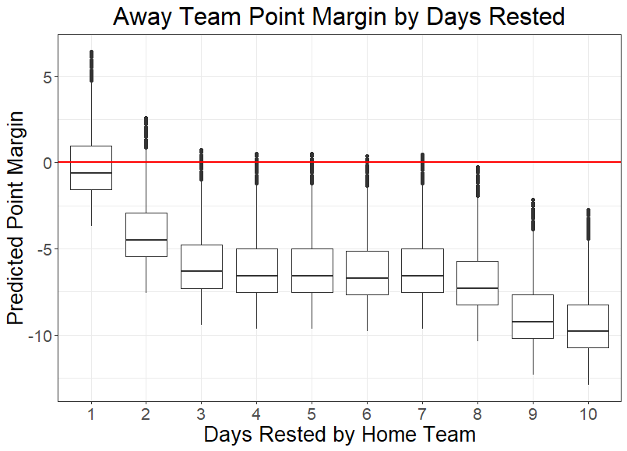
Distance Traveled and Home Team Rest Negatively Impacted Point Margin

Slide 4
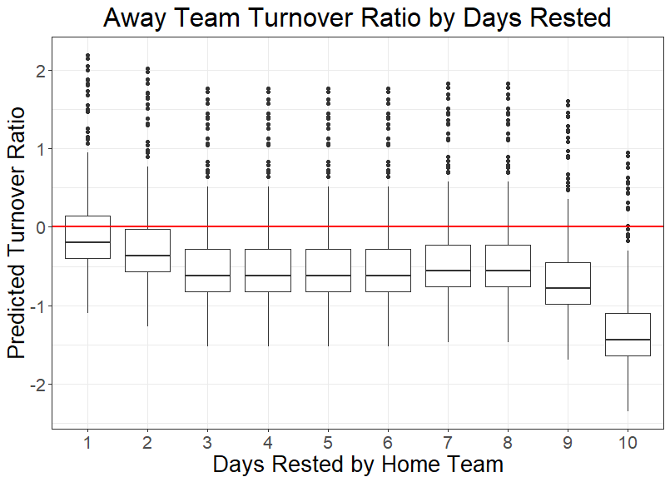
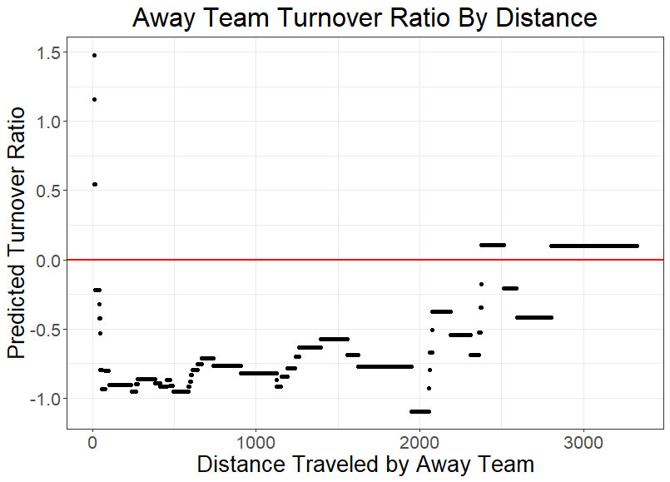
Distance Traveled and Home Team Rest Negatively Impacted Turnover Ratio

Slide 5
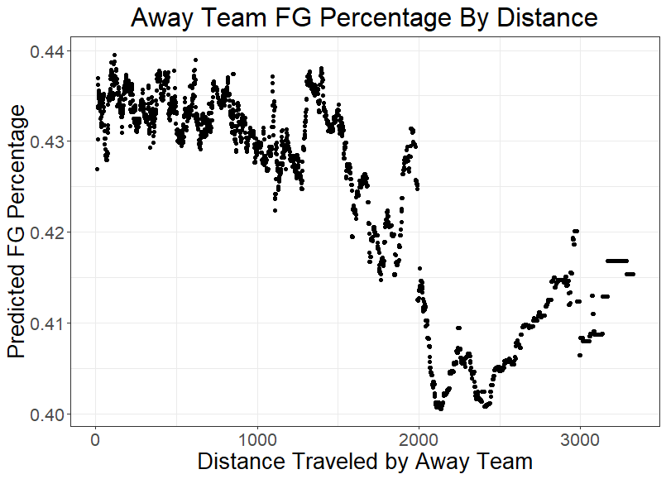
Distance Traveled Negatively Impacted Field Goal Percentage

Slide 6
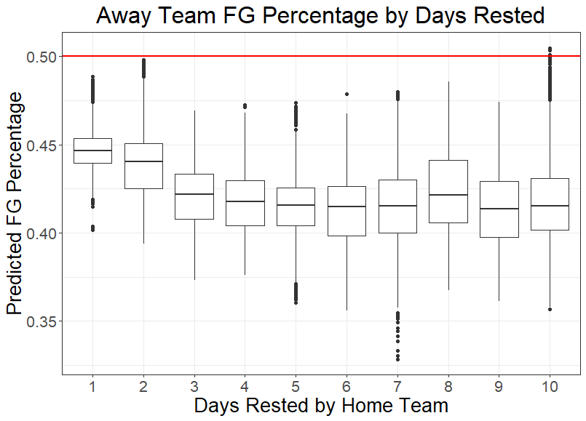
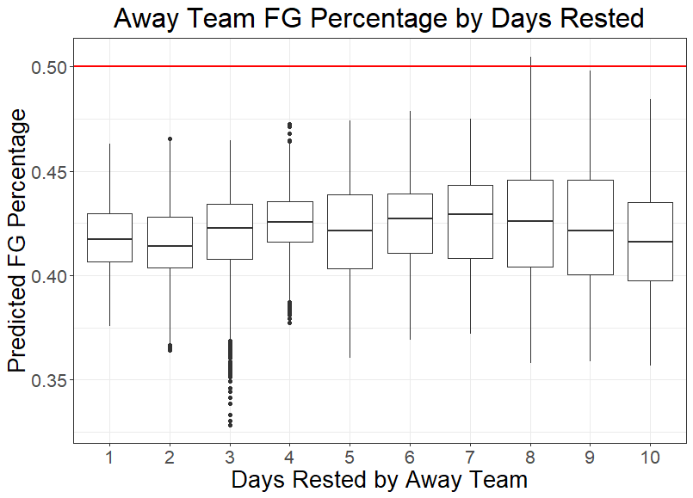
Away Team Struggled to Shoot Over 50% and Home Team Rest Continued to Negatively Impact Percentage

Slide 7
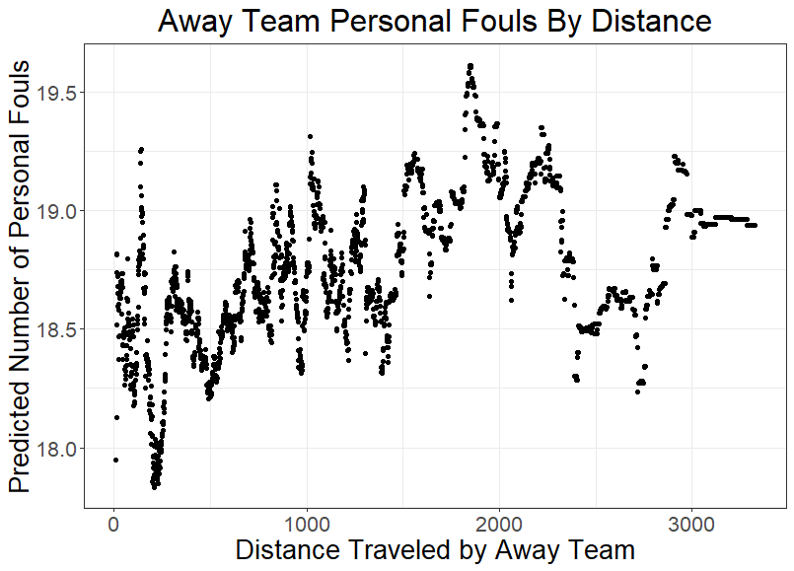
Distance Traveled Negatively Impacted Number of Personal Fouls

Slide 8
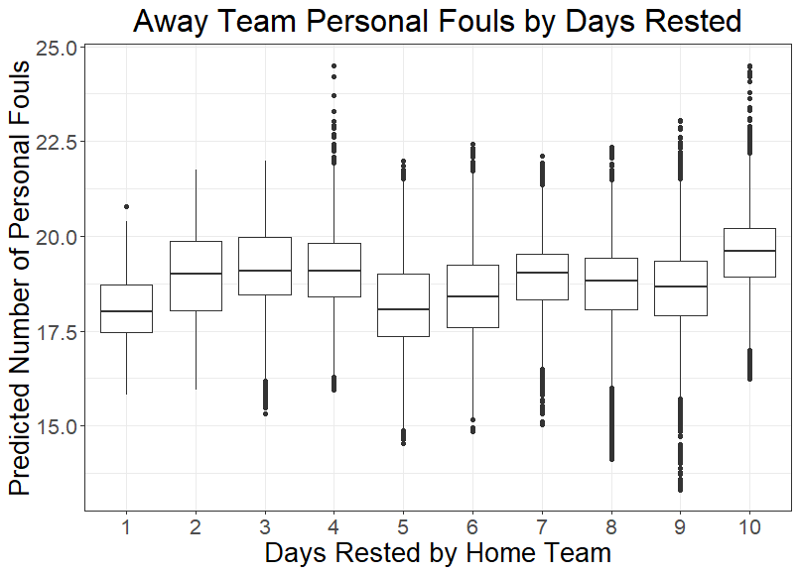
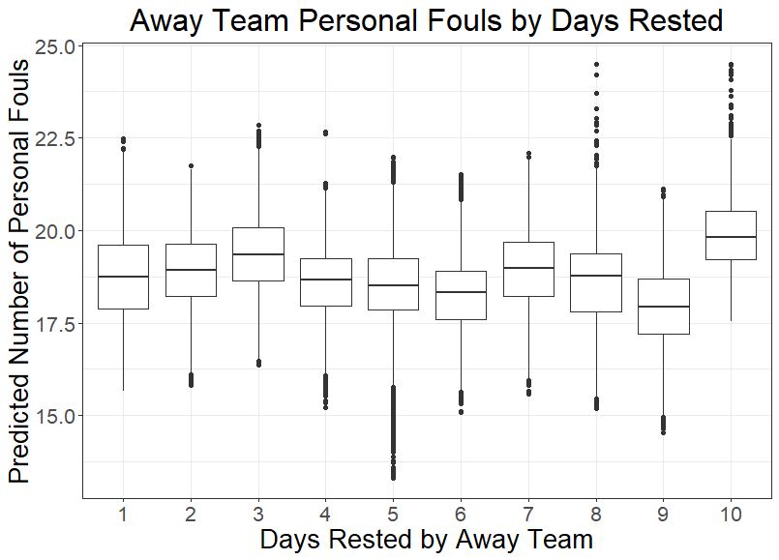
Effect on Number of Personal Fouls by Time Rested was Unclear and may Need Further Analysis

Slide 9
Models Produced Significant Results; Incorporating Results Should be Next Step
Producing a better strength of schedule metric is plausible using distance traveled and time rested
Models could be used to determine how much weight should be placed on teams that travel more or rest more
Away team always had the disadvantage, which increased with further distances
Home teams that rested more increased the disadvantage, whereas time rested for away teams had less of an effect.
Models did not predict win/loss consistently, further data and analysis should be done
These should be factors included in future strength of schedule models

